Slide 1
Week9 Activities
Cloud Services
Tevin Herath

Slide 2
Attacks
Ransome attacks: To simulate this attack, I created encryption decryption scripts to encrypt and decrypt a given file.
Its import to keep investigate and analyses open ports to prevent such attacks coming through
Also, it’s imports to check for antivirus status and run scans.
I have developed script (text-host.ps1) to scan the host for weakness.

Slide 3
GitHub Account
Git account containg those slides as well as the developed scripts are uploaded to this repository: https://github.com/crimescene123/cyber
I have included self reflection ☺

Slide 4
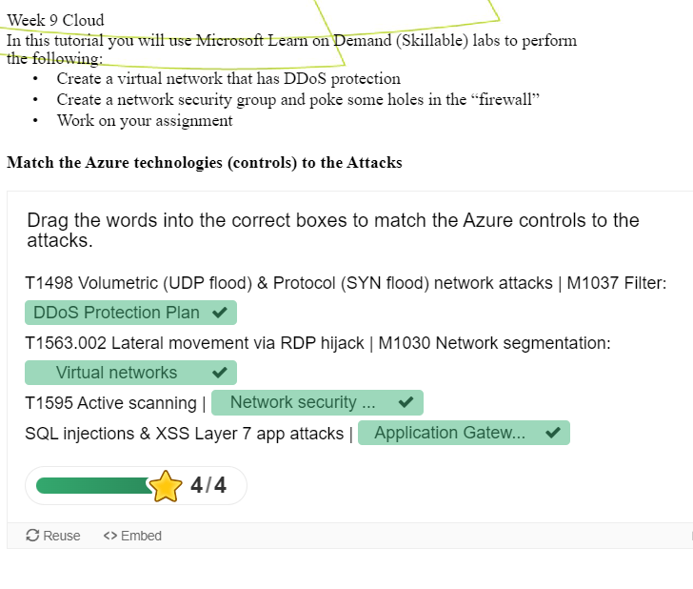
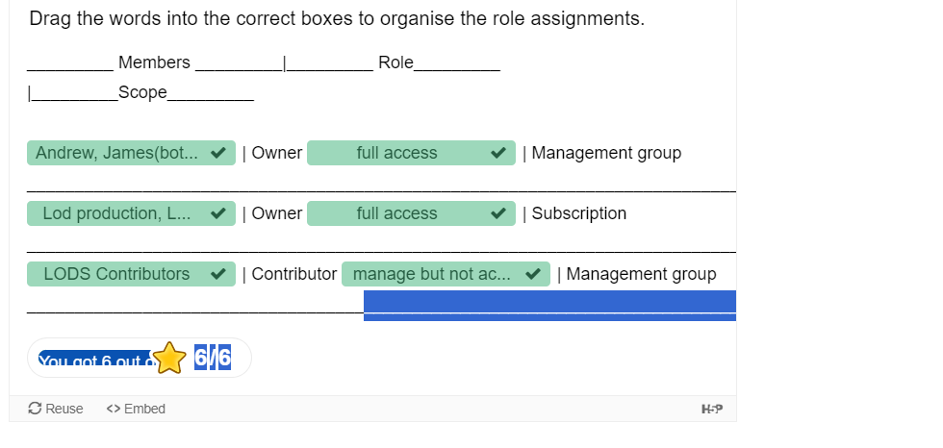
Week 9 Handout

